Slide 1
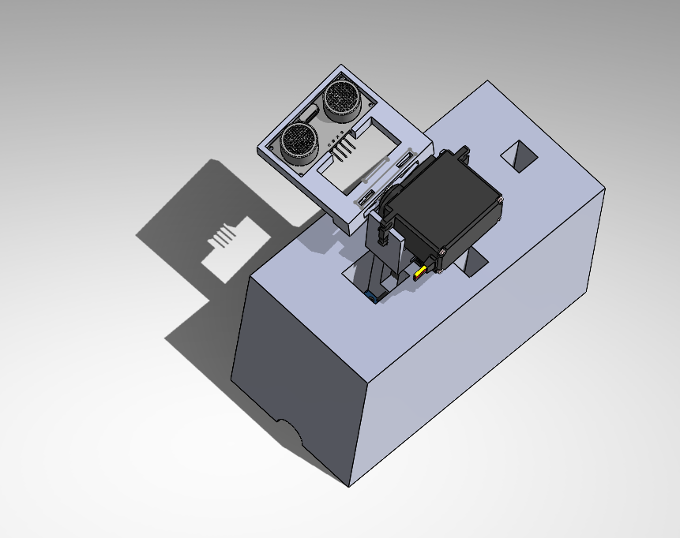
SoNAR Drone Defensive Detection in 3D Spaces (SoDDD 3DS)
For:NREIP By: Matthew Sieger

Slide 2


Table of Contents
1. Personal Introduction
2. Objectives
3. Needs Analysis
4. Improvements Over Existing System and Scan Shape
5. Setup
6. Theory and “Mapping”
7. Expectations
8. Future
9. What I Learned

Slide 3
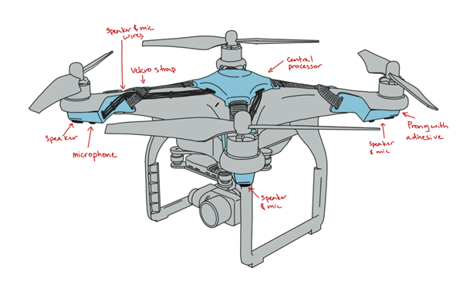



Introduction (Me)
Cal Poly Pomona - Aerospace Engineering
Senior Standing - 3.96 GPA
NASA Proposal - Drone Active Noise Cancellation in Noise-Polluted Geographies
Soups - 30 Countries

Slide 4
Program Objectives
Red Team Objectives | My Objectives
1. Detect enemy drones reliably and quickly without unfair false positives | 1. Make a SoNAR system with less than 5% false positives
2. Be able to detect them in the widest area possible | 2. Increase the scan from 15 degrees to 135
SoDDD 3DS and 2DS can detect enemies with <5% false positives

Slide 5
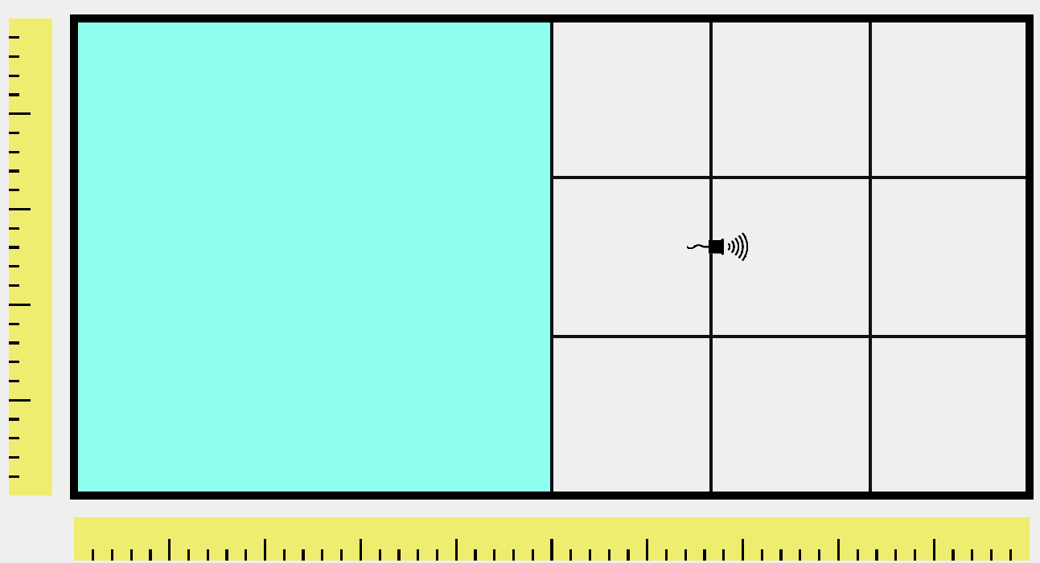
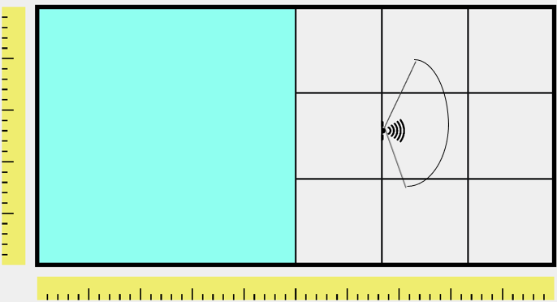

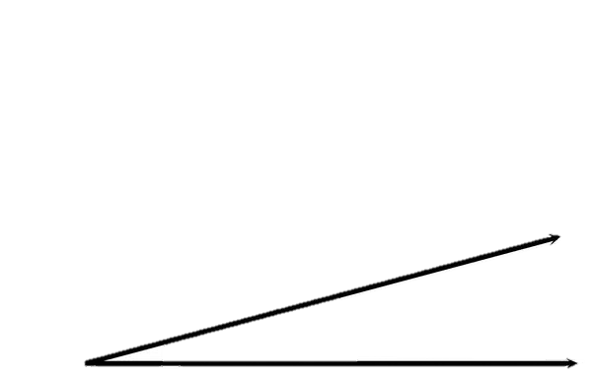
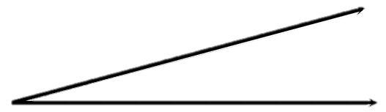
Faceoff Part 1
SoDDS drastically increases detection area
Old (15°x15°)
SoDDD 2DS (15°x135°)
SoDDD 3DS (135°x135°)
SoDDD 2DS & 3DS has dramatically increased detection area over original architecture

Slide 6
System Candidate Architectures Faceoff Part 2
Architecture (Surf Area) | % of a Sphere Scanned | Baselines/Maps | False + | Error dependent on Setup?
Non-Rotating Sensor | 0.5% | 0 | 0-50% | Yes
SoDDD 2DS | 4.3% (x9) | 24** | 0.3-0.6% | No
SoDDD 3DS | 32.6%* (x63) | 24** | 2.7-7.0% | No
SoDDD 2DS has 9x increased detection area & 3DS has 63x over original architecture

Slide 7
3D Range Demo

Slide 8
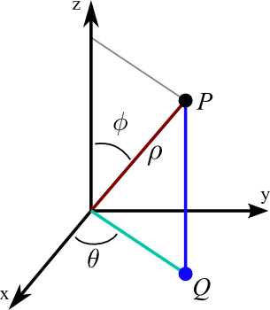
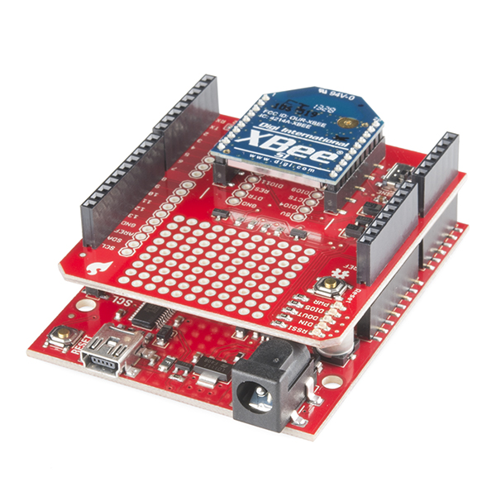
How it Works
1-2 Servos + 1 Ultrasonic + XBee
SoDDD 3DS uses two servos to control ϕ & θ. The US measures ρ and sends coordinates via Zigbee

Slide 9
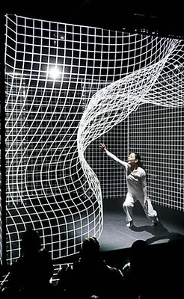
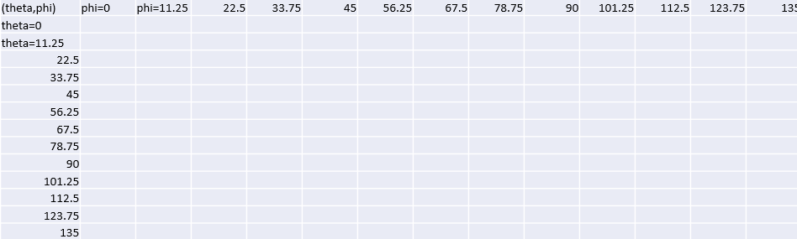
Mapping Aspect
Baseline maps
13x13 matrix
(24in,23°,0°)
Location of element in matrix corresponds to a ϕ & θ

Slide 10
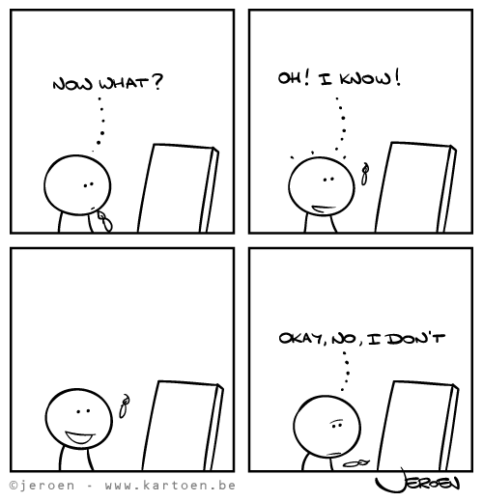
False Positives
Previously, no filter
notTooFar
deviatesEnough0<Distance<8ft
Filters are used to find detections with <5% false positive rate

Slide 11
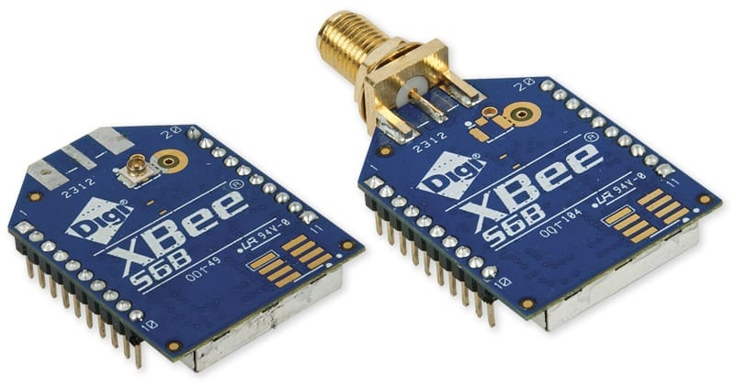
Expectations Shattered
XCTU errors
Library clash
Servo only 130 degrees
Software compatibility, libraries, and hardware/software mismatch added time to project

Slide 12
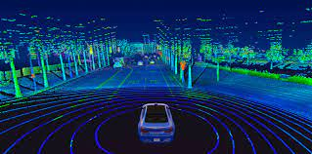
Limitations and Future
LiDAR should be used
4x distance improvement
Detects Smaller Objects
LiDAR allows 4x detection distance improvement and smaller drone detection

Slide 13

What I learned
75-25 Completion Rule for CAD and Software
Work with what is on-hand
Collaboration
Integration
Last 25% takes ¾ of total time. Collaboration is needed for success

Slide 14


Slide 15

Questions?

Slide 17
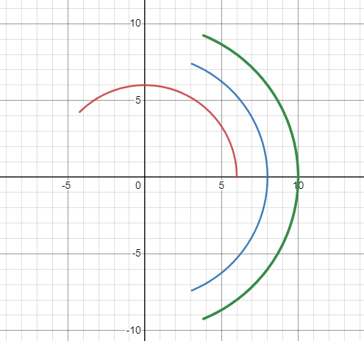
Calculations for Position
Servo Midpoint of Total Sweep
Servo Midpoint of Total Sweep
GUI 50% Midpoint of Total Sweep
GUI 50% Midpoint of Total Sweep
Degree increments * rows and columns
Centering: Rotation – servoMaxDegrees/2
Servos go from 0-130 degrees
Rotation_{Actual}= -1 * Rotation
If phi <0, phi= -phi & theta=theta+180 degree
Translations align where GUI and servo think the system is pointed towards

